Slide 1
Raiders
and
Reivers

Slide 2
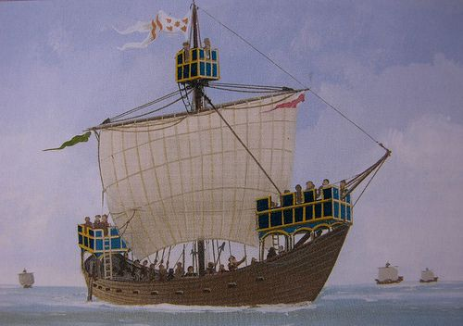
A Hanseatic Cog

Slide 3
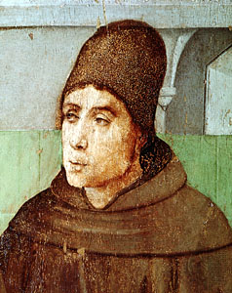
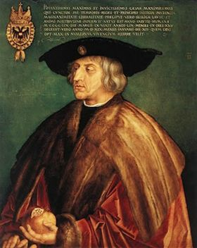
John of Duns
“Duns Scotus”
Sir Michael Scott
“The Wizard”

Slide 4
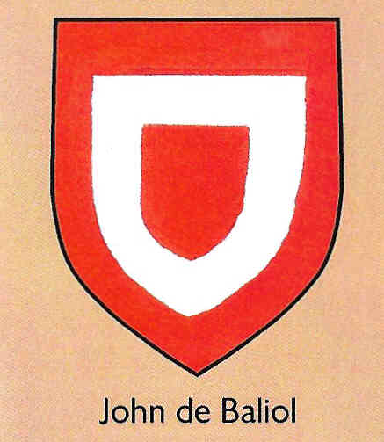
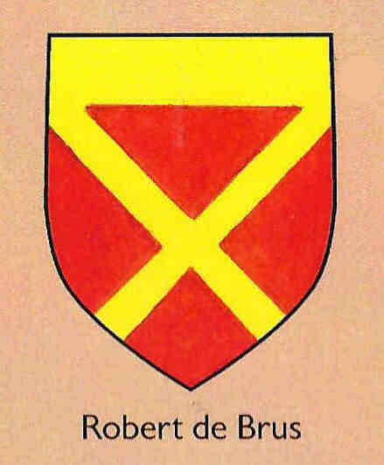
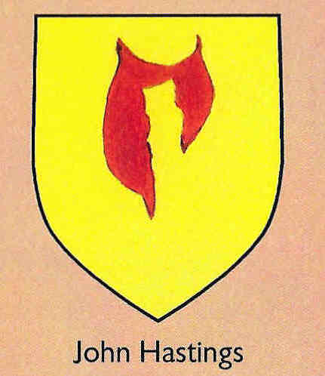
The Arms of the three main contenders
for the Crown of Scotland, 1292

Slide 5
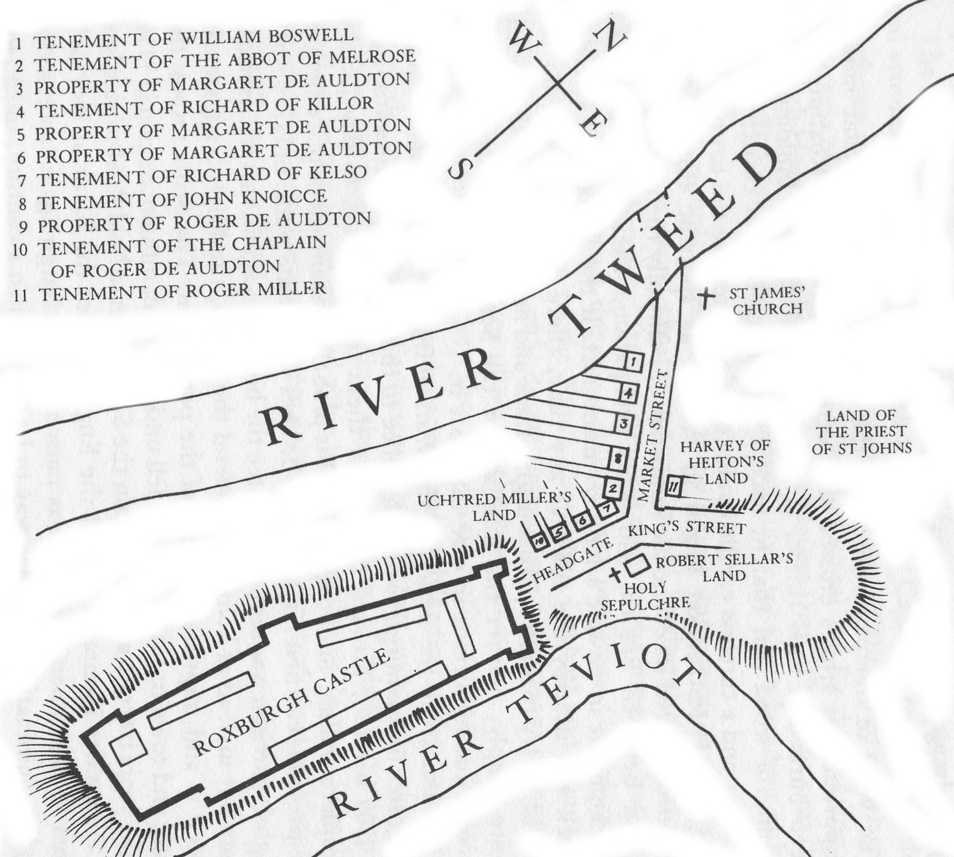
Tenement of William Boswell
Tenement of The Abbot of Melrose
Property of Margaret of Auldton
Tenememt of Richard of Killor
Property of Margaret of Auldton
Property of Margaret of Auldton
Tenememt of Richard of Kelso
Tenement of John Knoicce
Property of Roger de Auldton
Tenement of the Chaplain of Roger de Auldton
Tenement of Roger Miller
St James Church
Land of the Priest of St John
Harvey of Heiton’s Land
Uchtred Miller’s Land
Robert Sellar’s Land
Holy Sepulchre
Plan of Roxburgh
c. 1250

Slide 6
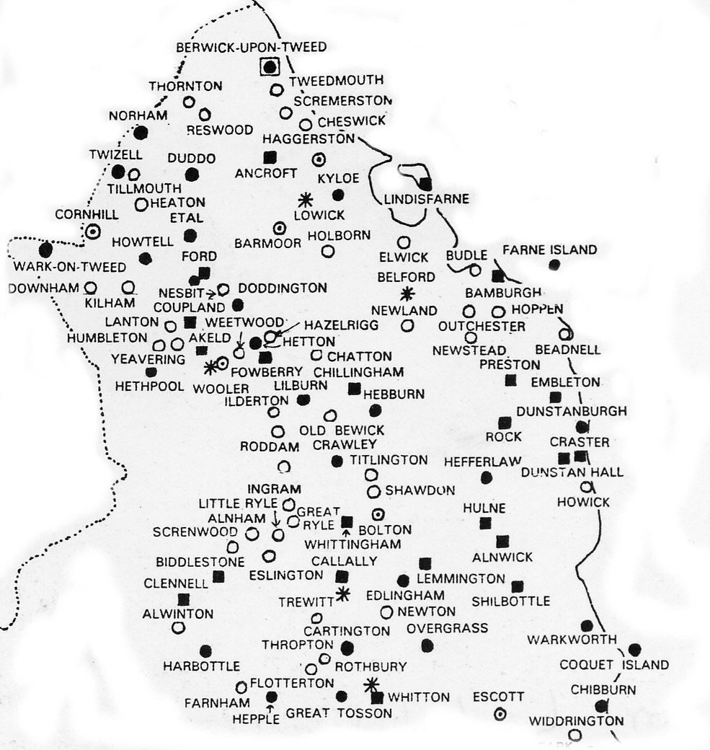
Castles and Towers in Northumberland
c. 1415

Slide 7
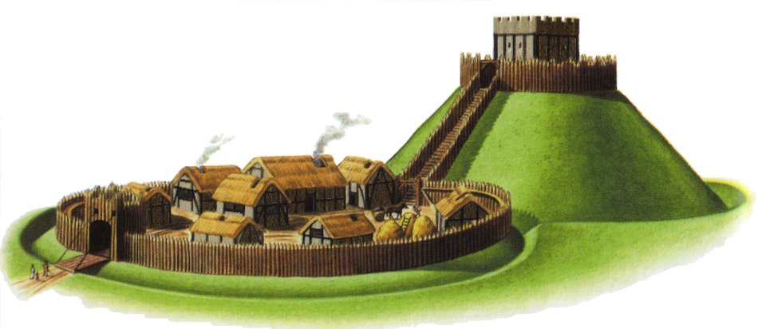
A Norman motte and bailey castle

Slide 8
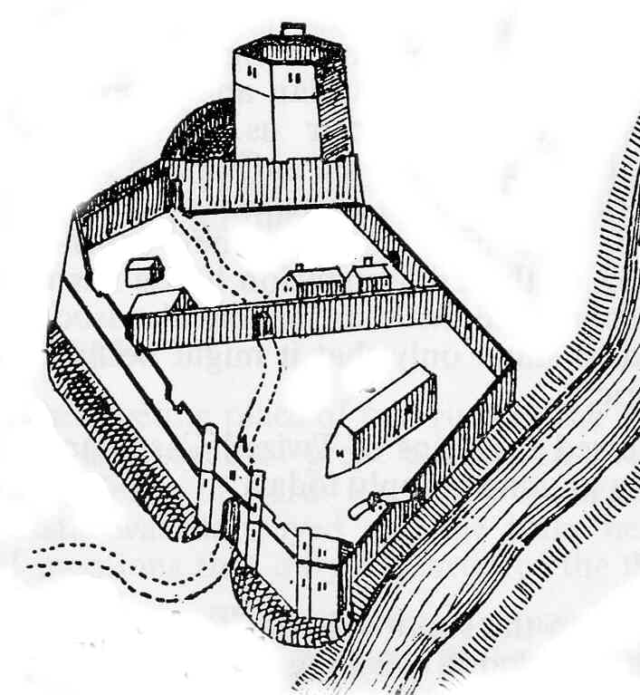
Wark on Tweed Castle c. 1120

Slide 9
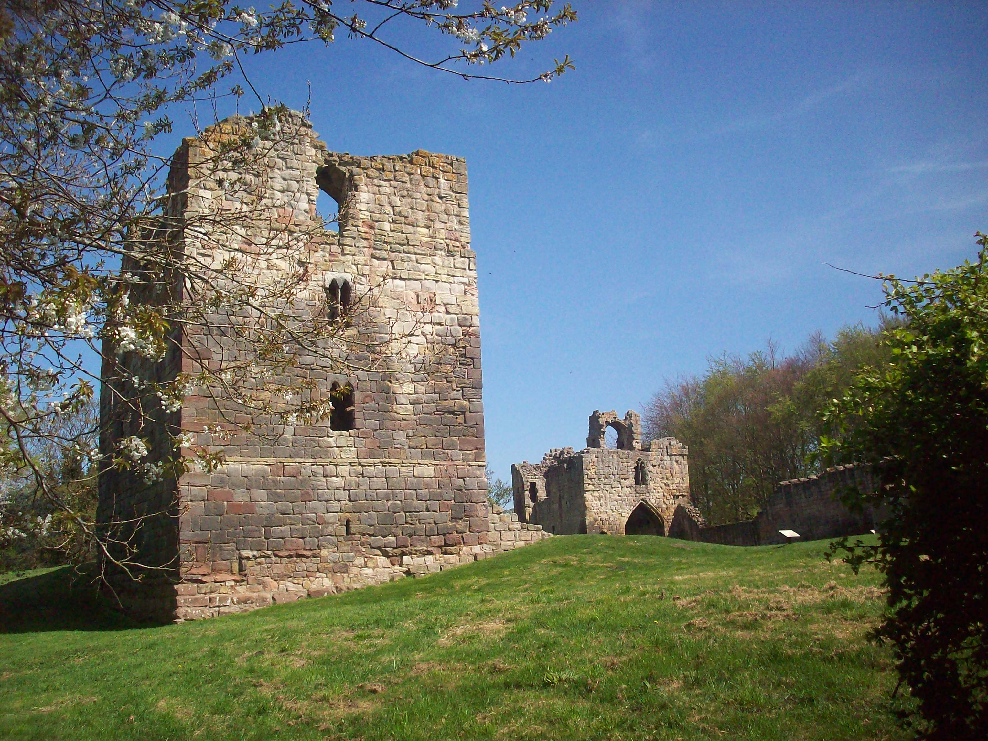
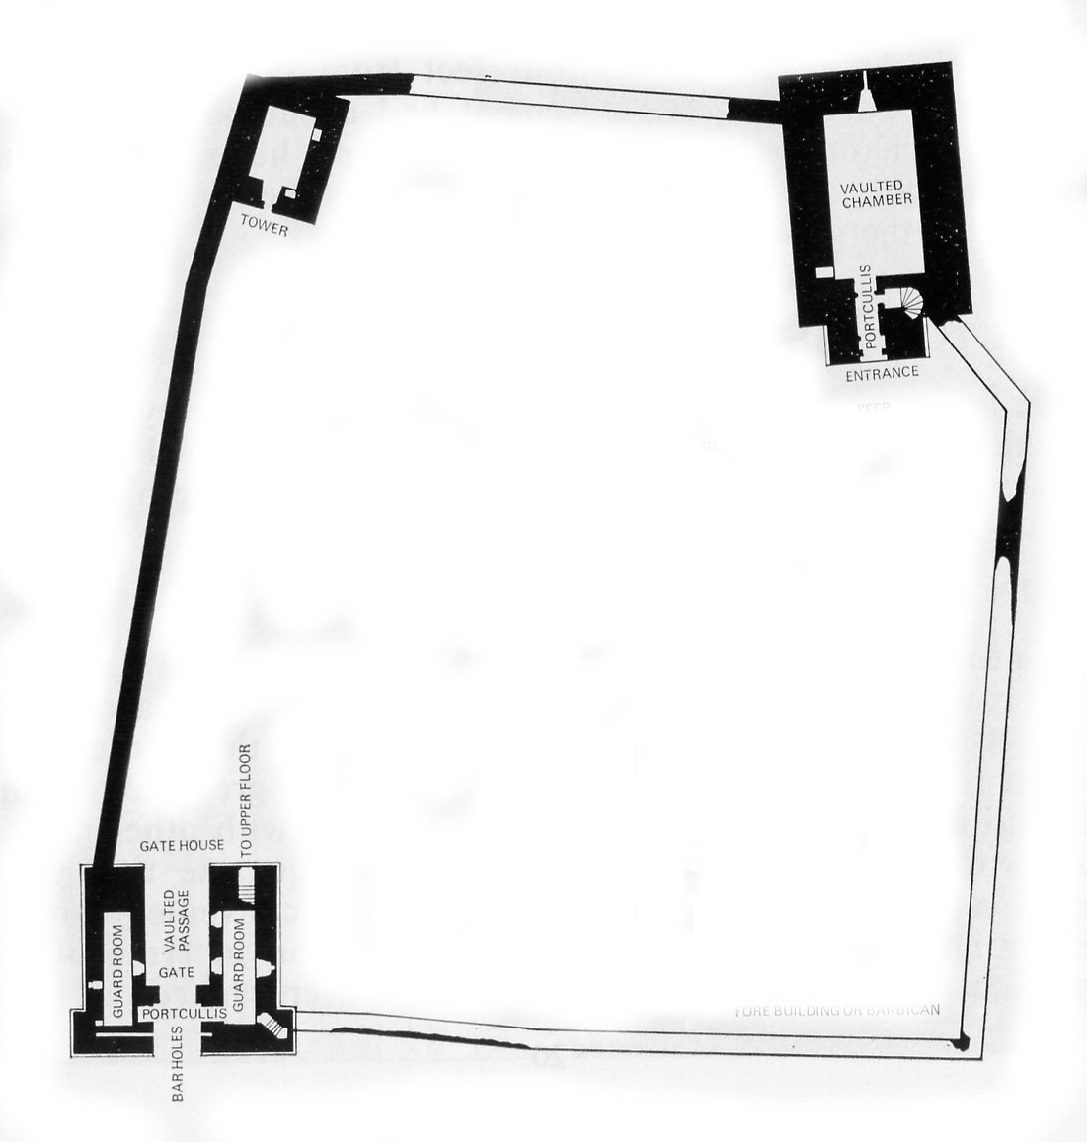
Etal Castle
Etal Castle
c. 1341

Slide 10
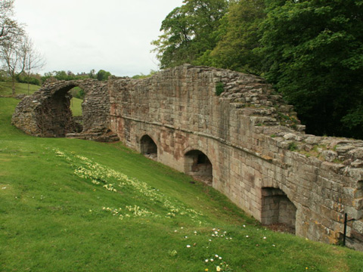
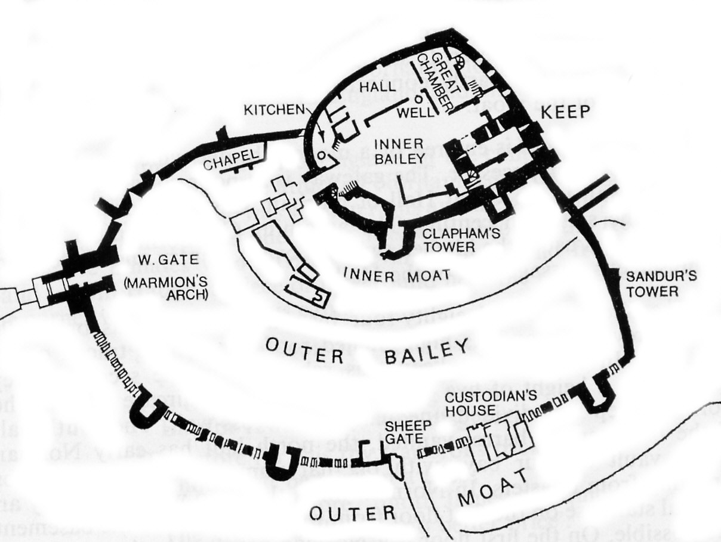
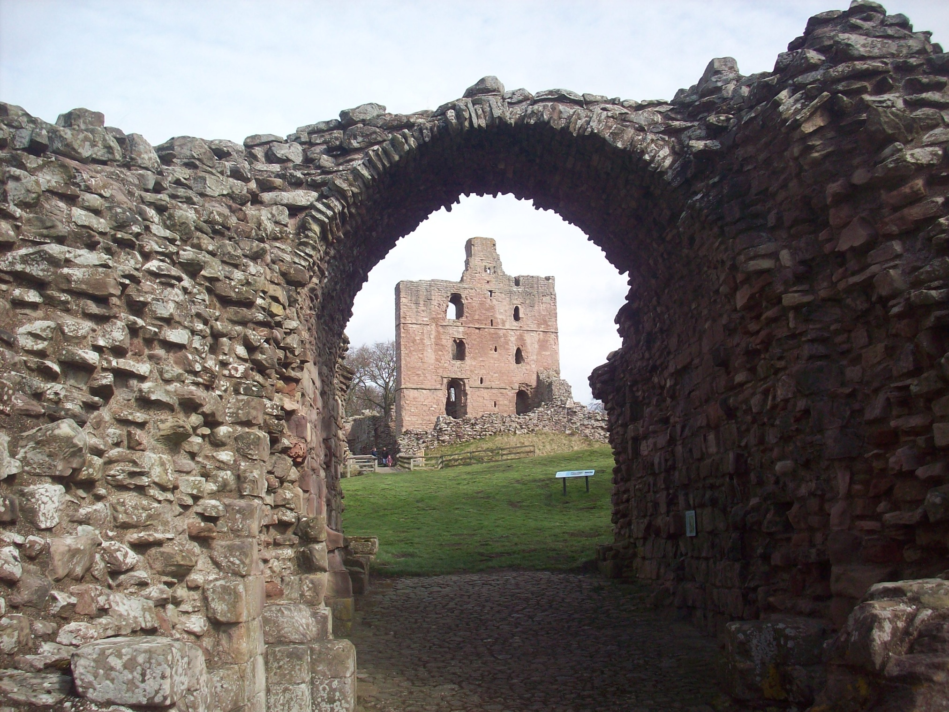
Norham Castle, c. 1121
Built 1121 by Ranulph Flambard, Bishop of Durham
Norham Castle, 16th century gun embrasures

Slide 11
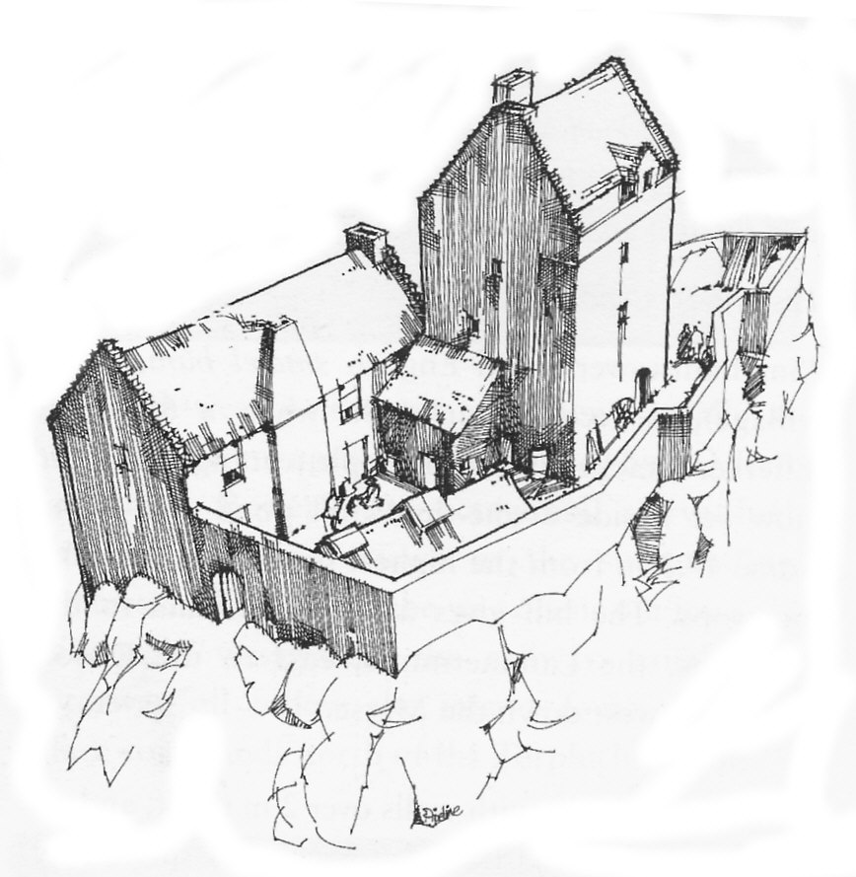
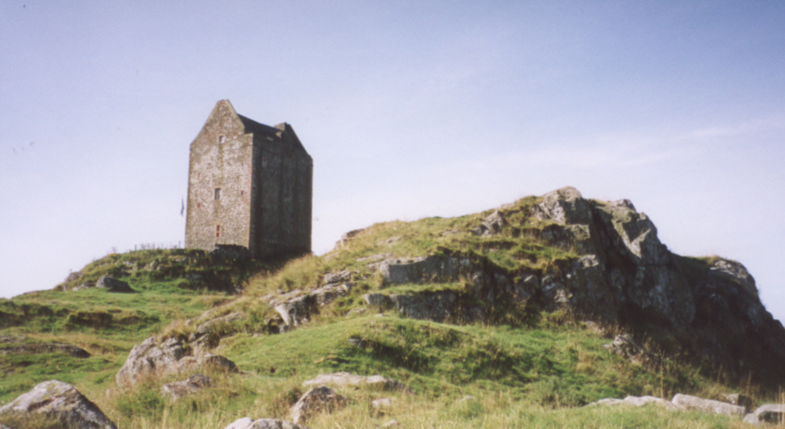
Smailholm Tower
Smailholm Tower
c. 1500

Slide 12
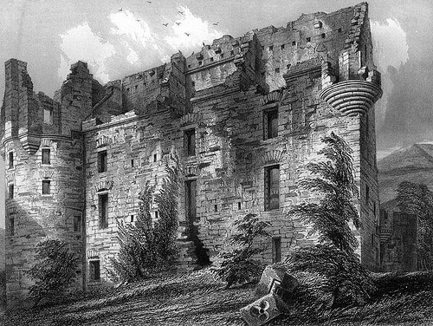
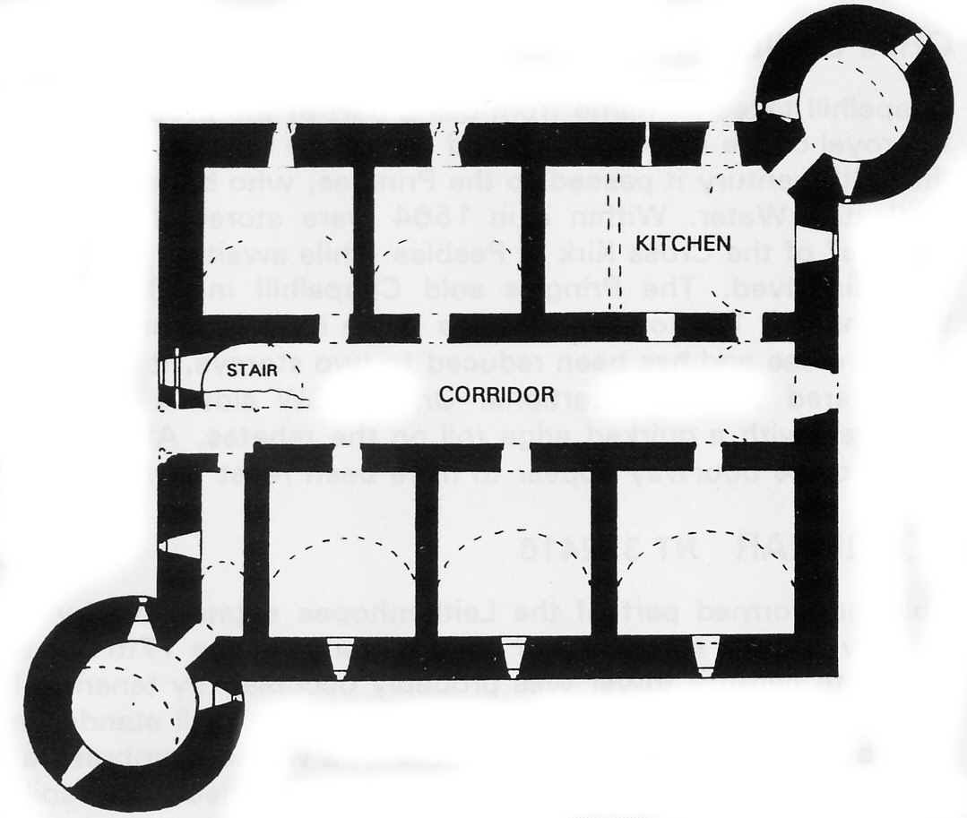
Drochil Castle,
West Linton
C 1575

Slide 13
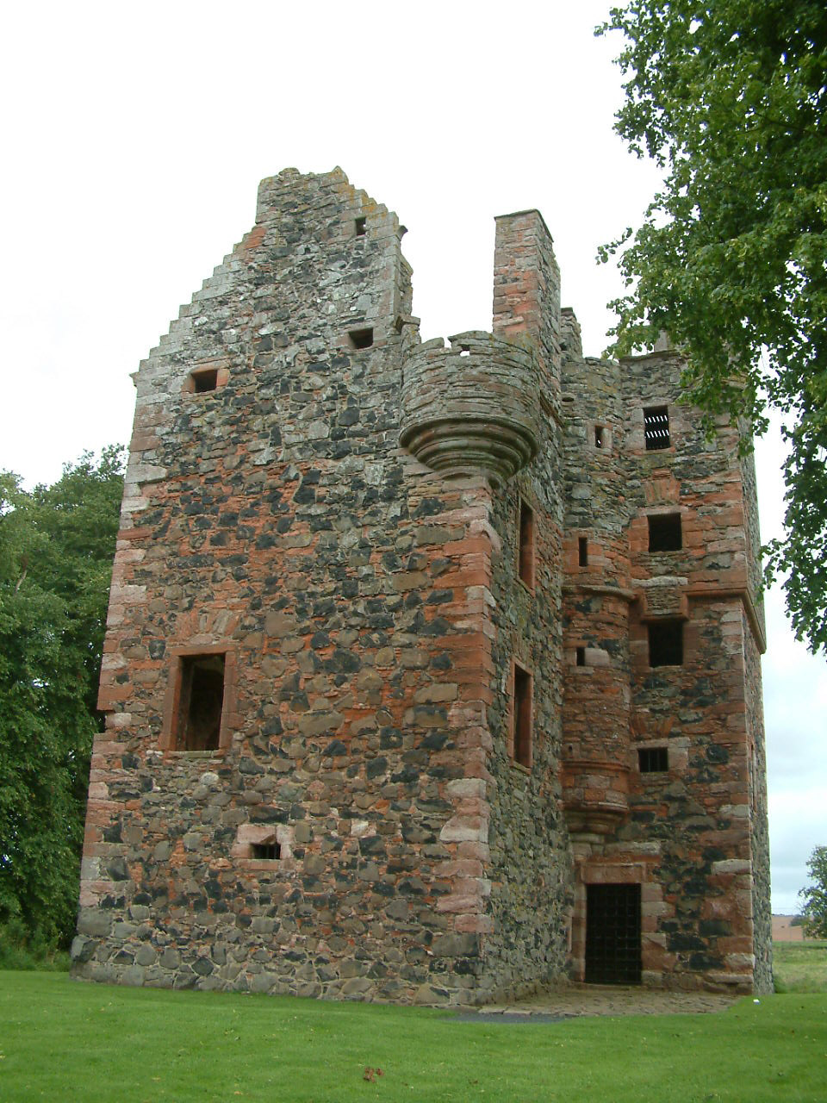
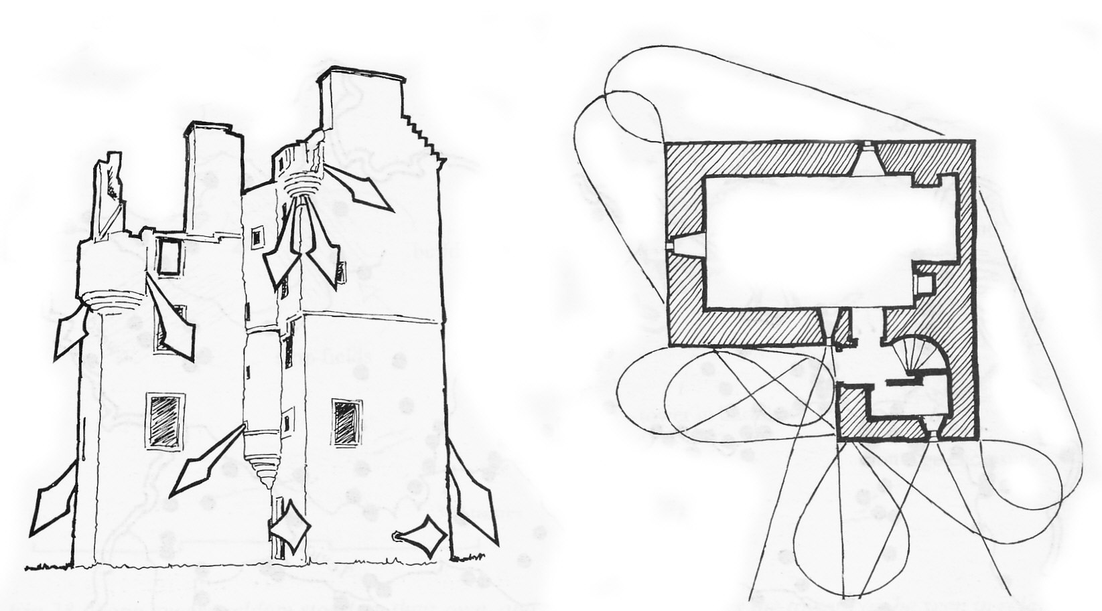
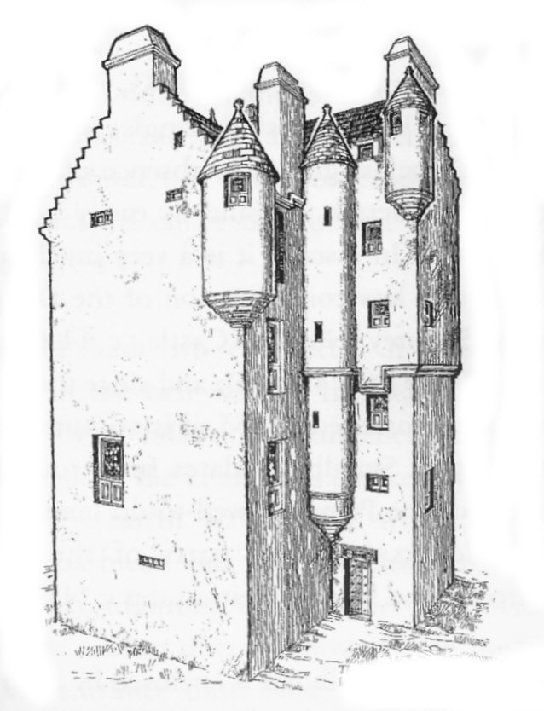
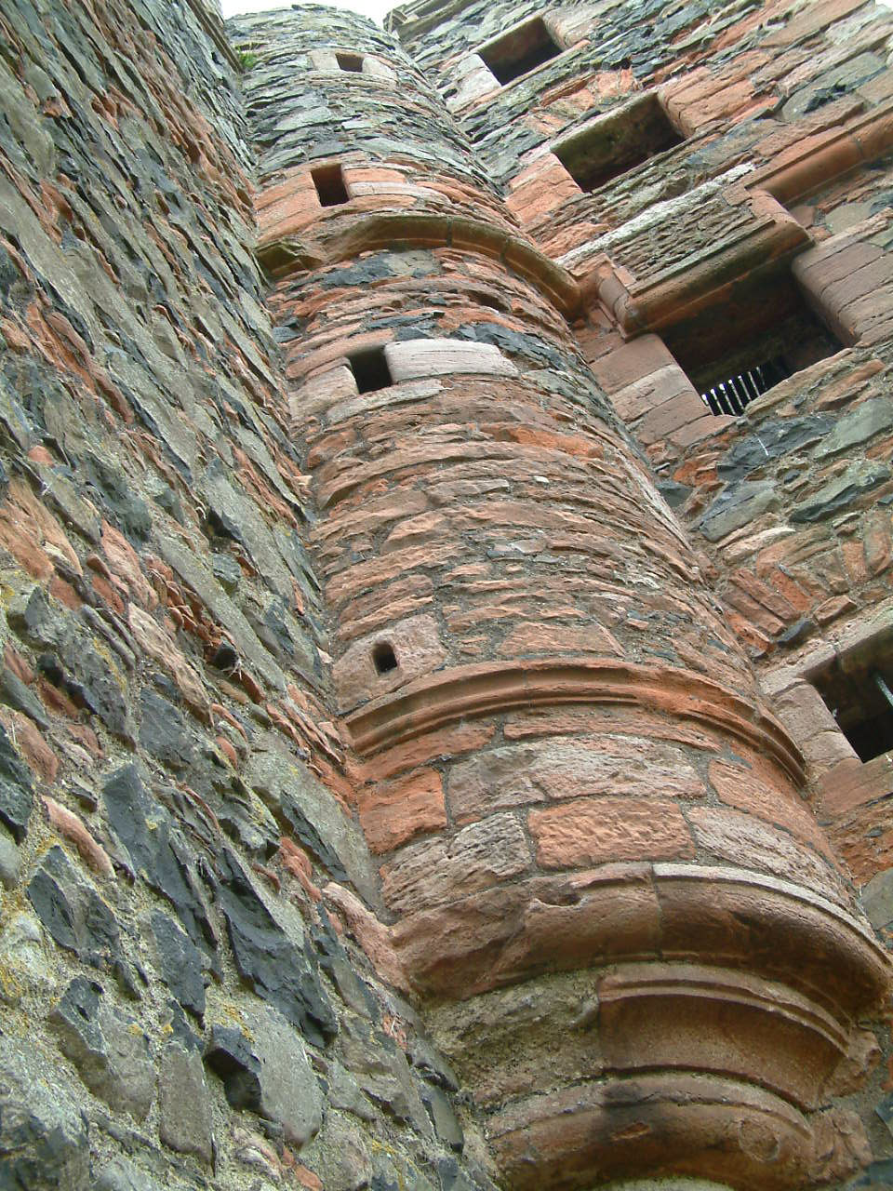
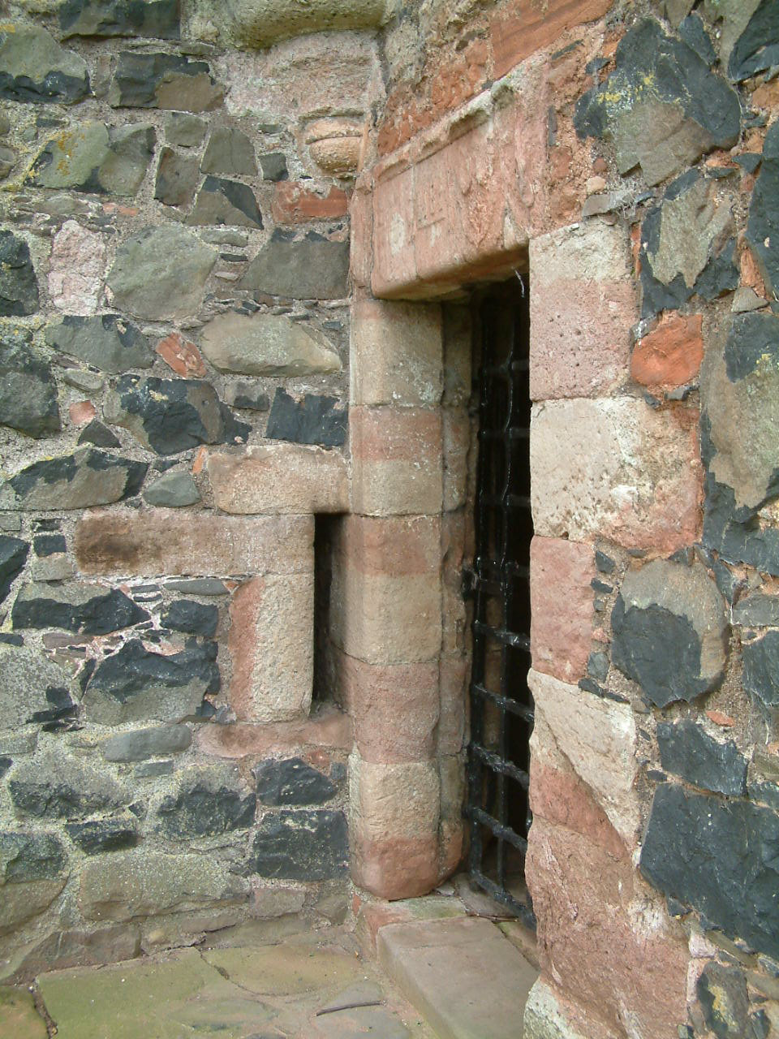
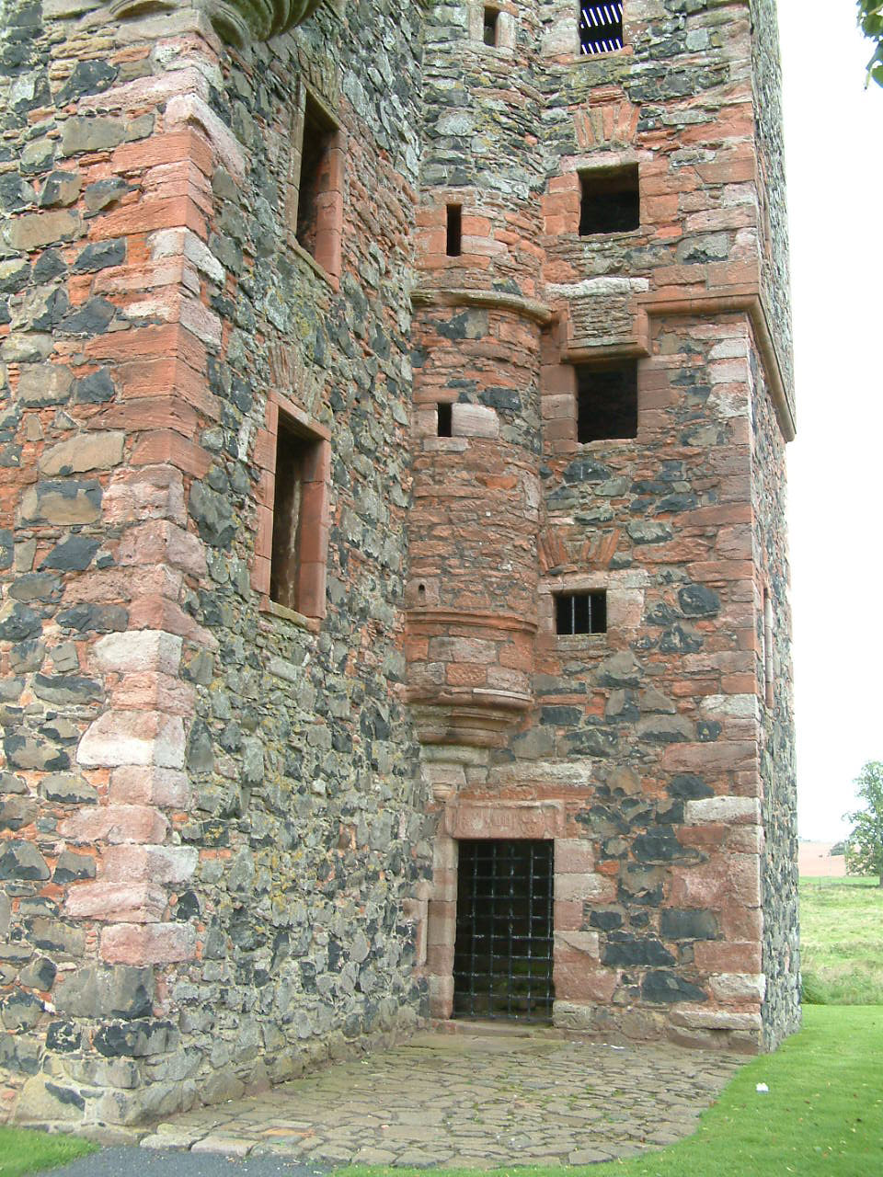
Greenknowe Tower, 1591

Slide 14
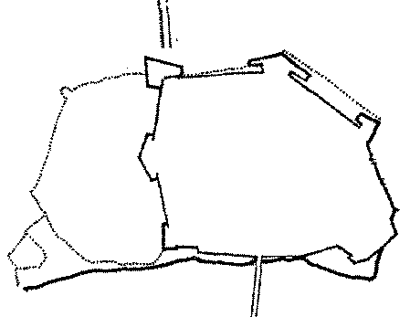
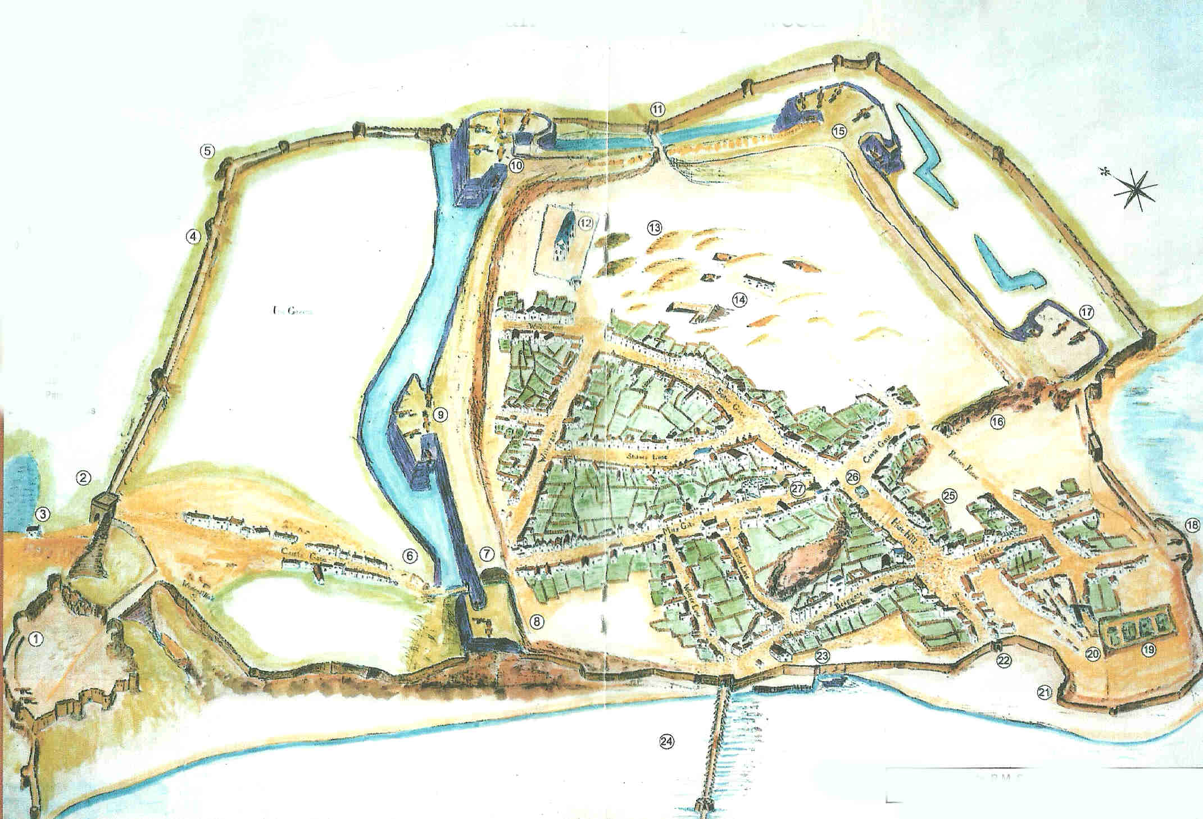
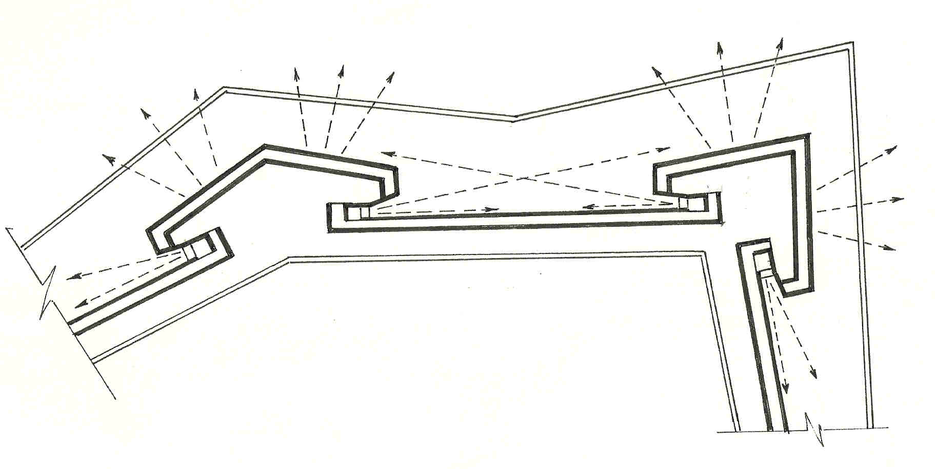
Original design for
Berwick’s fortifications,
c. 1558
Berwick-upon-Tweed
Circa 1571

Slide 15
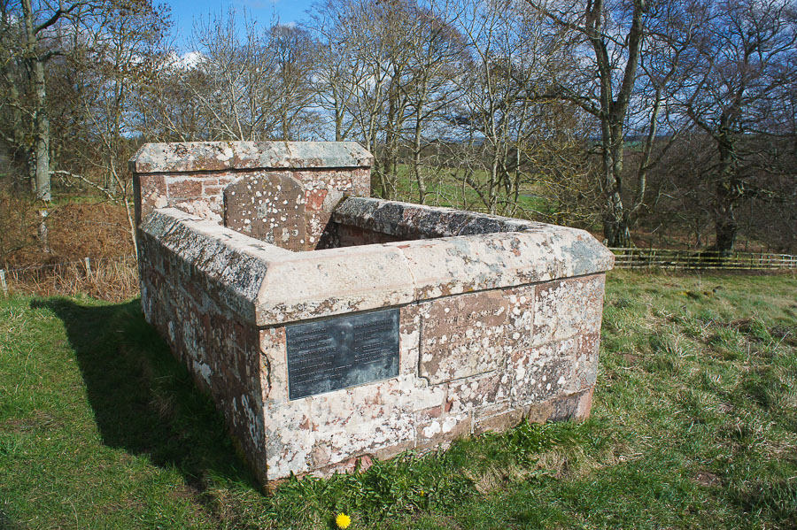
Lilliard’s Stone,
Ancrum Moor

Slide 16
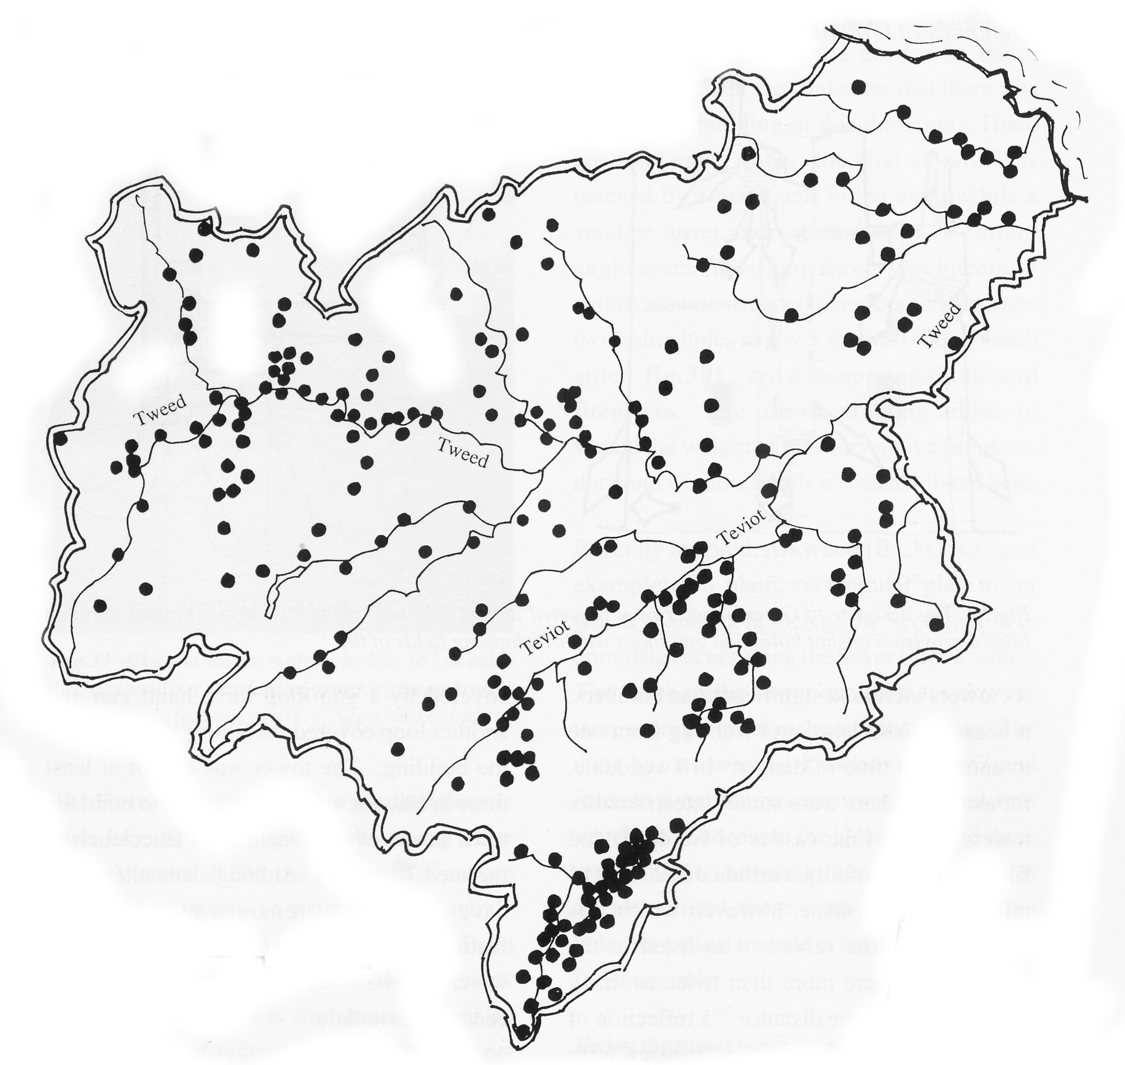
Towers in the Scottish Borders in the 16th Century

