Slide 1
One Nation or Two?

Slide 2
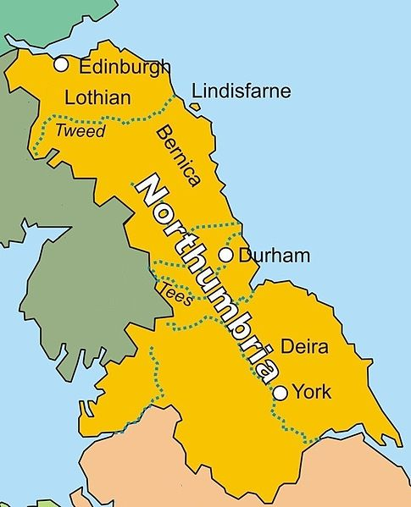
THE KINGDOM OF NORTHUMBRIA c. 800AD

Slide 3
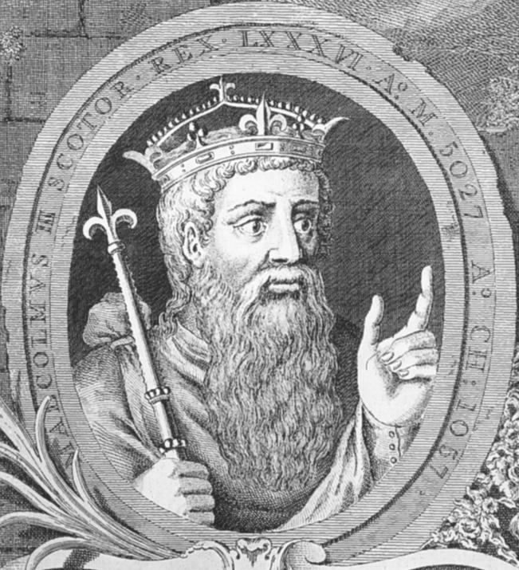
Malcolm III of Scotland “Canmore”

Slide 4
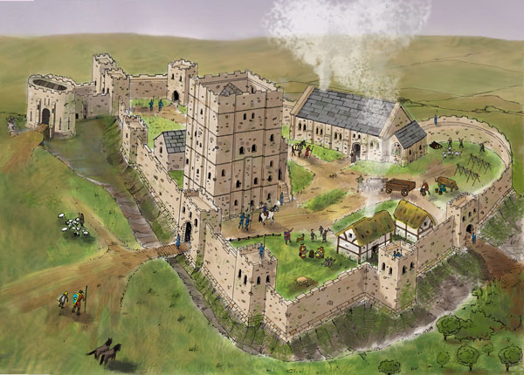
The New Castle, circa 1200

Slide 5
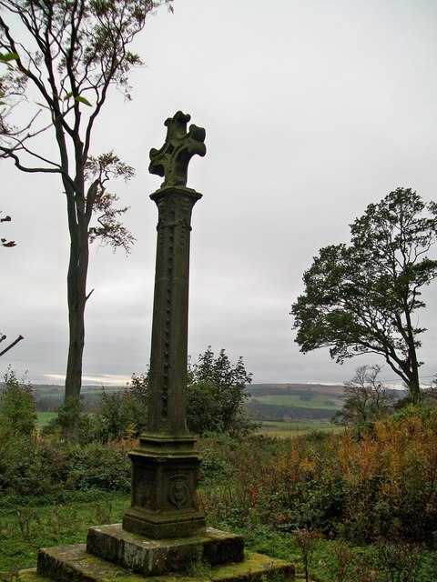
Malcolm’s Cross, Alnwick

Slide 6
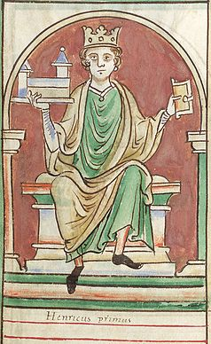
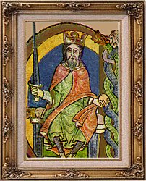
King David I
of Scotland
Henry I
of England

Slide 7
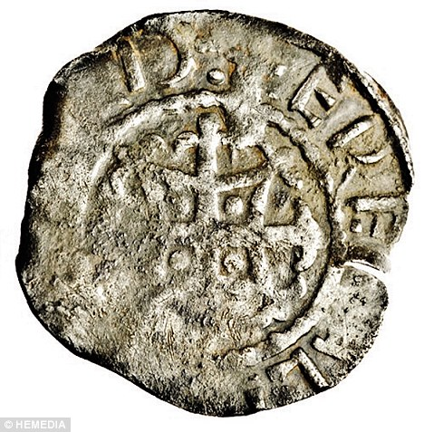
Silver Penny of
King David I
of Scotland

Slide 8
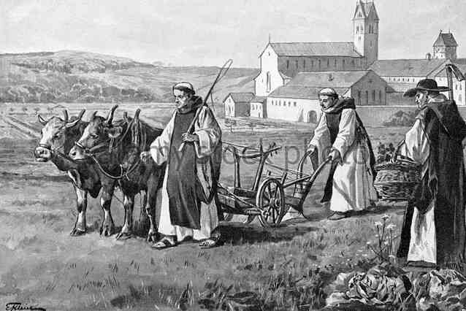
Cistercian monks cultivating their estate

Slide 9
THE MONKS’ DAILY ROUTINE
1.30 am Matins, the first service of the day
3.00am Lauds
4.00am Prime, followed by Mass
4.30am Meeting of the Chapter
7.00am-9.00am Work and Study
9.00am Terce
11.00am Sextus
Lunch and “siesta”.
3.00pm Nones
Afternoon Work and Study
6.00pm Vespers, then supper and readings
7.00pm Compline
8.00pm Monks retired to bed

Slide 10
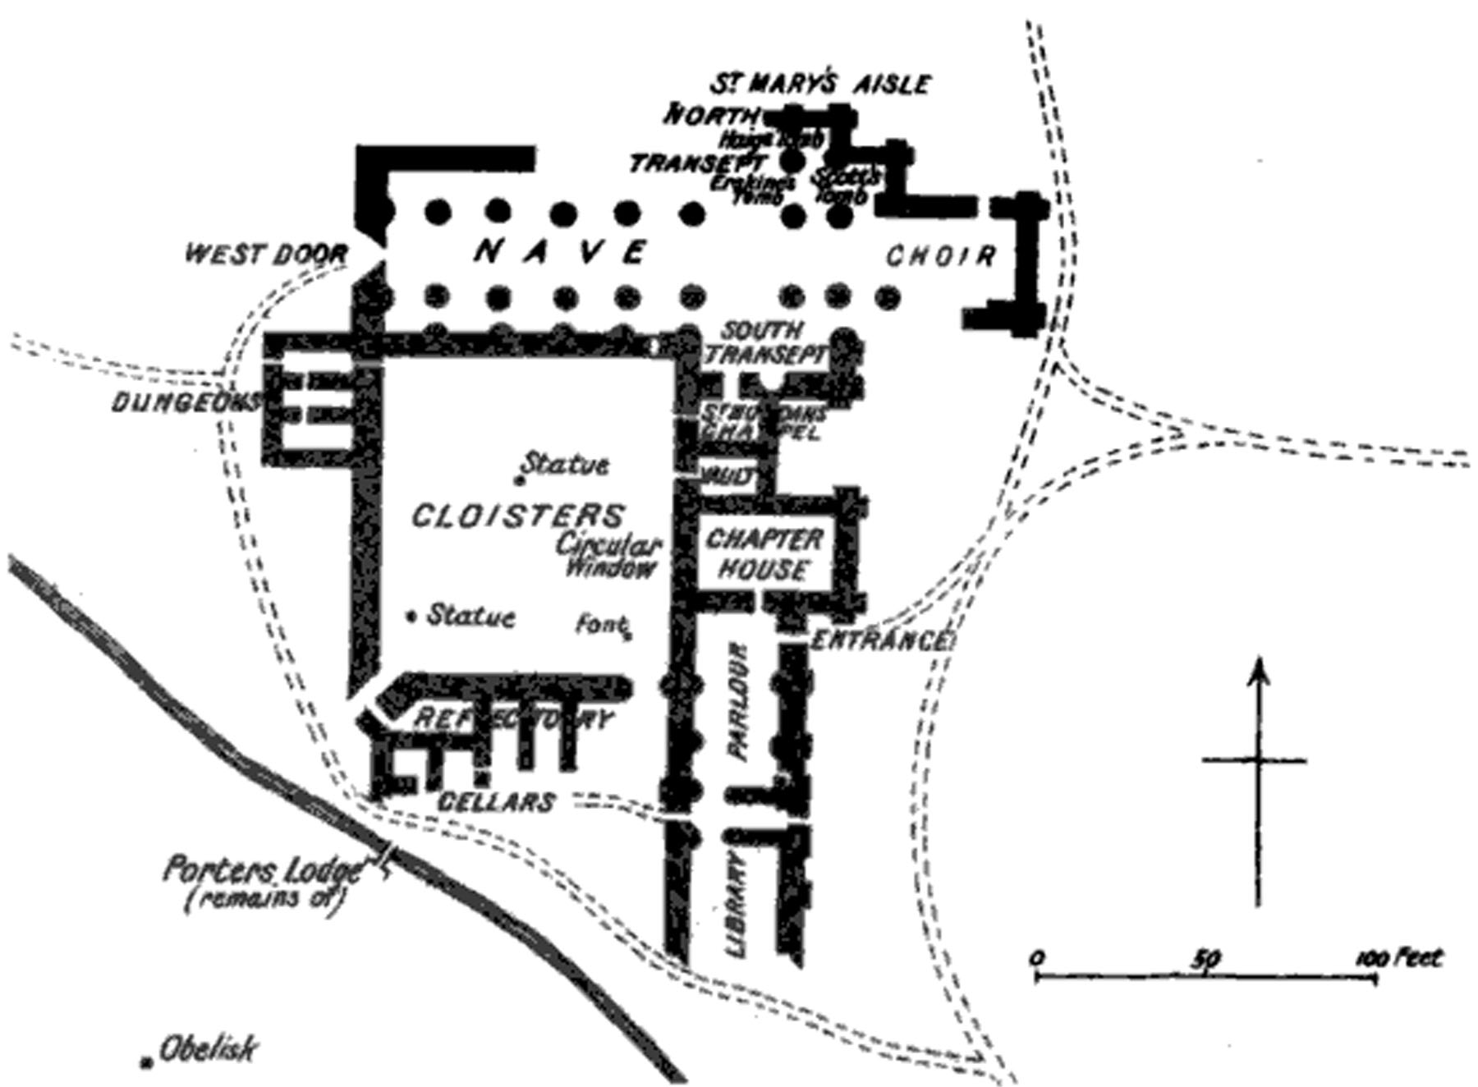
DRYBURGH ABBEY – A PREMONSTRATENSIAN MONASTERY

Slide 11
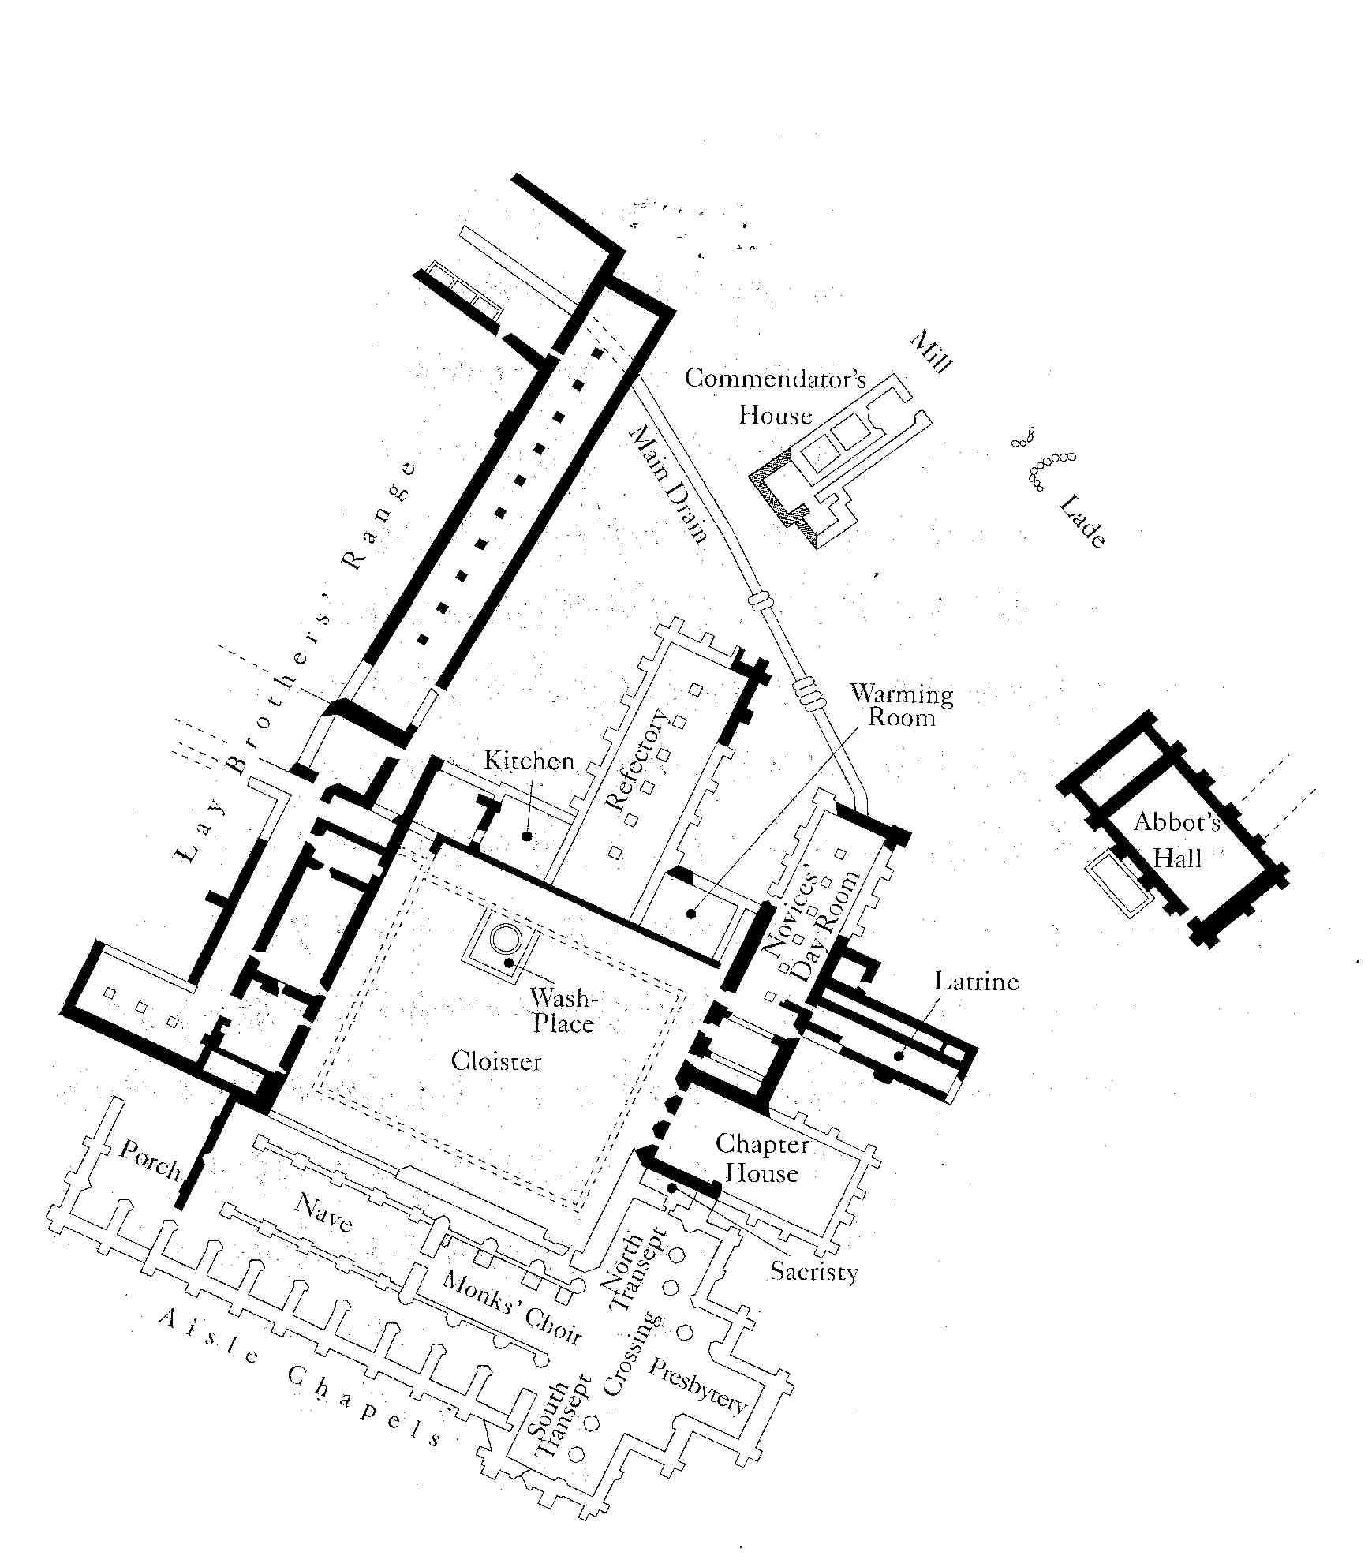
MELROSE ABBEY –
A CISTERCIAN MONASTERY

Slide 12
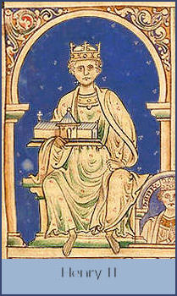

Slide 13
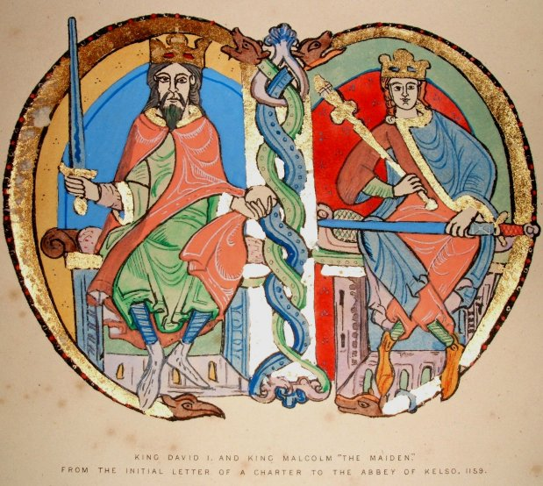
King David I of Scotland
King Malcolm IV “The Maiden”

Slide 14
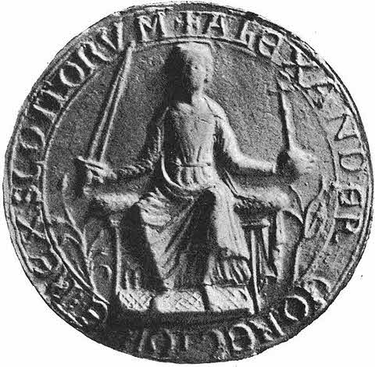
Coin of
King Alexander II
of Scotland

